Slide 1
Arithmetic Operations with Neural Models

Slide 2
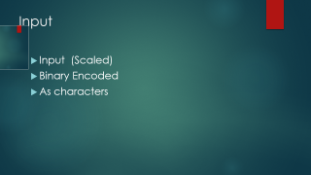
Input
Input (Scaled)
Binary Encoded
As characters

Slide 3
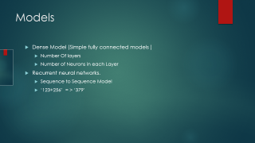
Models
Dense Model (Simple fully connected models )
Number Of layers
Number of Neurons in each Layer
Recurrent neural networks.
Sequence to Sequence Model
‘123+256’ = > ‘379’

Slide 4
Dense Model
For inputs:
Format 1: Scaled the inputs by dividing with largest number
Format 2: Converted numbers to binary format.
Output Format: Real Number

Slide 5
Using Recurrent Neural Network
Sequence to sequence:
Input as characters
From one sequence space to other Sequence space
1 2 3 + 1 2 3 => 2 4 6
One hot encoding for each charecter
Uses Softmax at final layer (Classification)

